Slide 1
Image Reconstruction from Point Cloud Generated by LiDAR
Mini Project Presentation
Orientation Course for Engineering and Science Graduates (OCES 2019)
Under the guidance of
Mr. Supratim Majumdar
CnID/E & IG
BARC
Abhilash Bhardwaj
TSO, Computer Science
HRDD, BARC

Slide 2
Overview of Presentation
LiDAR and its Applications
Point cloud representation
File formats and their attributes
Point cloud visualization: Used libraries
Point cloud visualization: GUI visualization tool
GUI application architecture
Visualization results
2D Image Experiments on Terrain Point Cloud
Conclusion
Future Work
References

Slide 3
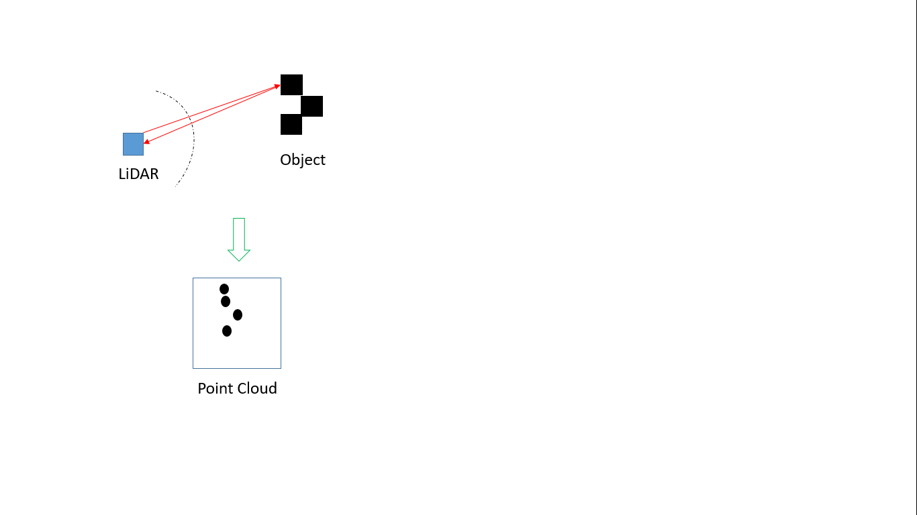
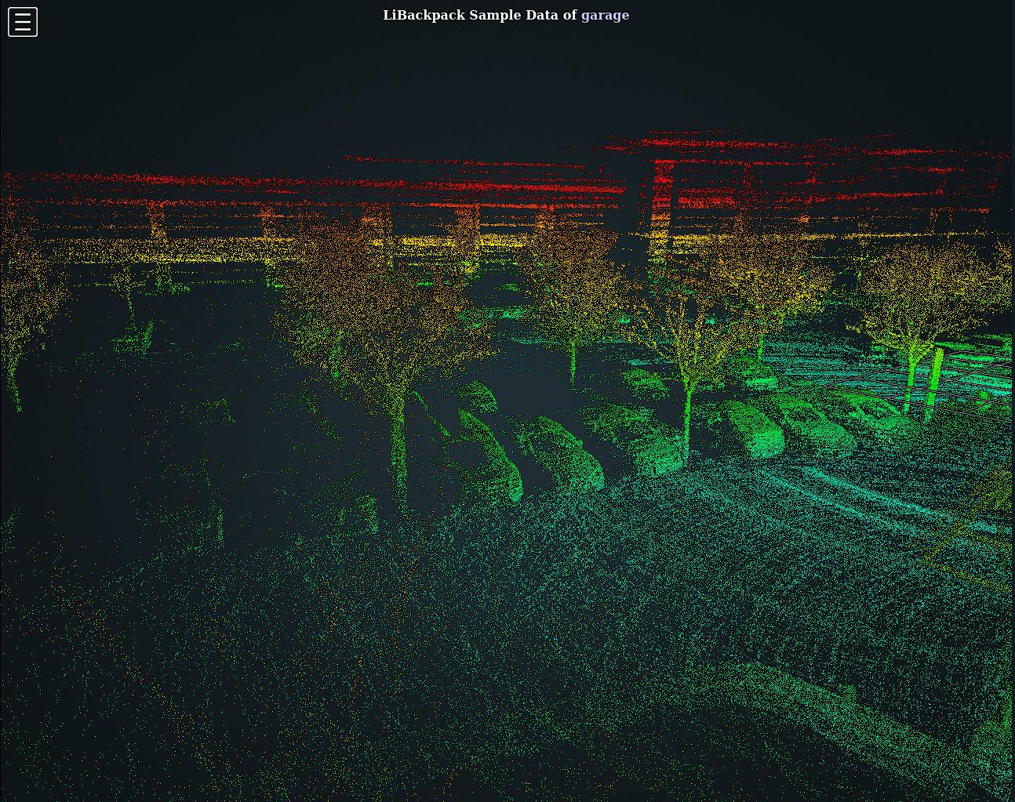
LiDAR and its Applications
Distance = (Speed of Light X ToF) / 2
Courtesy: Google Images

Slide 4
LiDAR and its Applications
LiDAR is particularly used to make high resolution maps with applications in geography, archeology, forestry, military etc.
LiDAR point cloud information is also used to generate realistic graphics.
It also finds its application in object detection and surveillance.
Self-driving cars where LiDAR will be used in real time to detect obstacles and navigation
In agriculture LiDAR can be used to make 3D elevation map of a particular land.

Slide 5
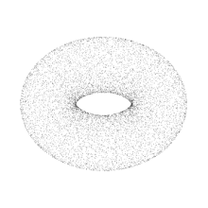
Point Cloud Representations
Popular formats to represent point cloud data –
LAS Format (.las)
PCD Format (.pcd)
CSV Format (.csv)
Sample of Point Cloud

Slide 6
File Formats and their attributes
LAS
X, Y, Z
Classification
Intensity
etc……….
# .PCD v.7 - Point Cloud Data file format
VERSION .7
FIELDS x y z rgb
SIZE 4 4 4 4
TYPE F F F F
COUNT 1 1 1 1
WIDTH 213
HEIGHT 1
VIEWPOINT 0 0 0 1 0 0 0
POINTS 213
DATA ascii
0.93773 0.33763 0 4.2108e+06
0.90805 0.35641 0 4.2108e+06
CSV
Col1,col2,col3
Data11,data12,data13
Data21,data22,data23
………………..
……………………..

Slide 7




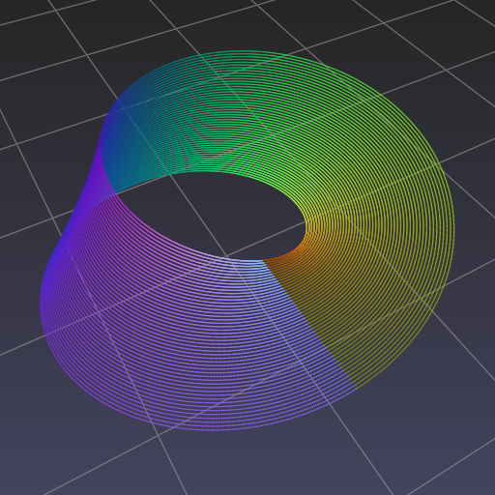


Point Cloud Visualization: Used Libraries
3D Plotting
Data Processing
GUI Development
Base Packages For Development
PPTK
laspy
PyPCD

Slide 8
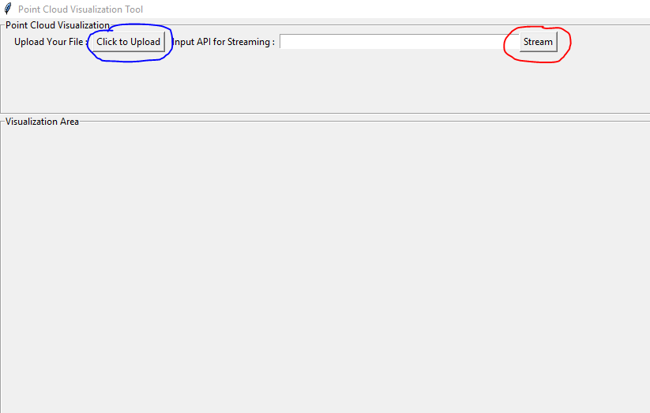
Point Cloud Visualization: GUI Visualization Tool

Slide 9
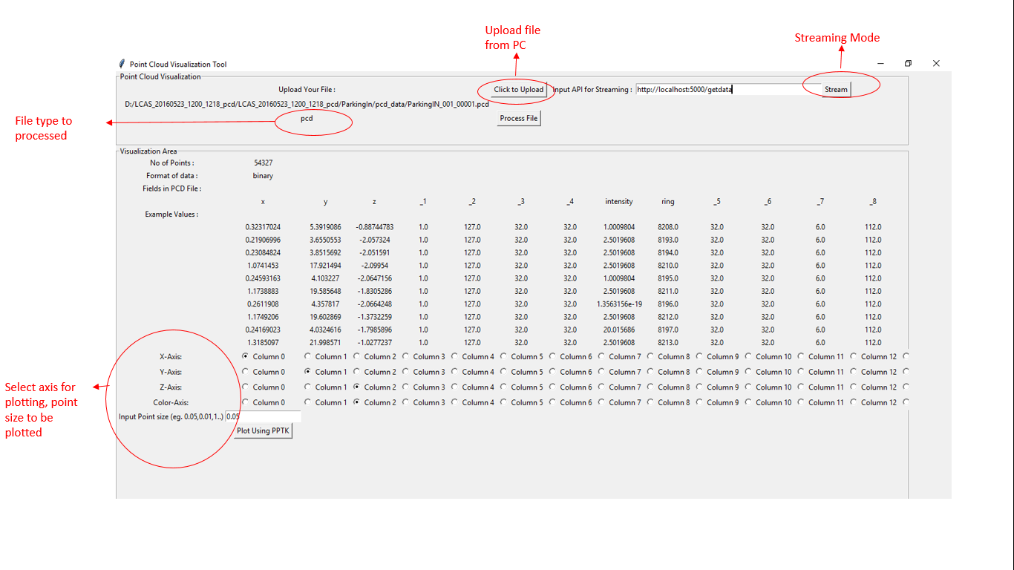

Slide 10
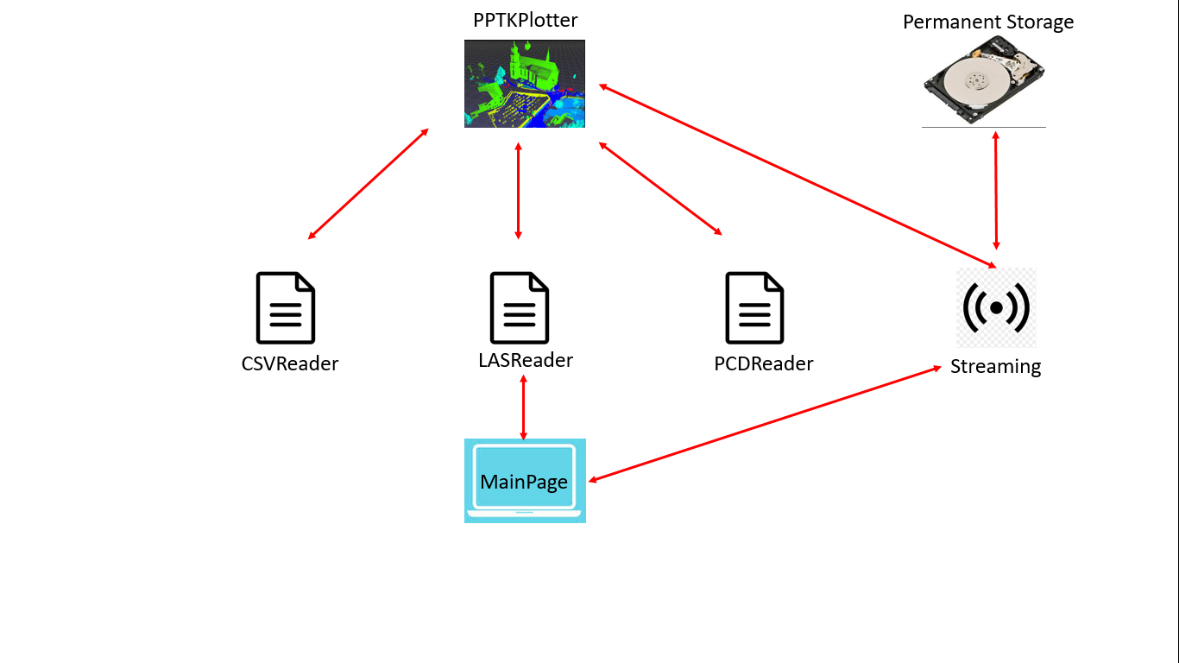
GUI Application Architecture
Modes of visualization
Streaming mode
File mode

Slide 11
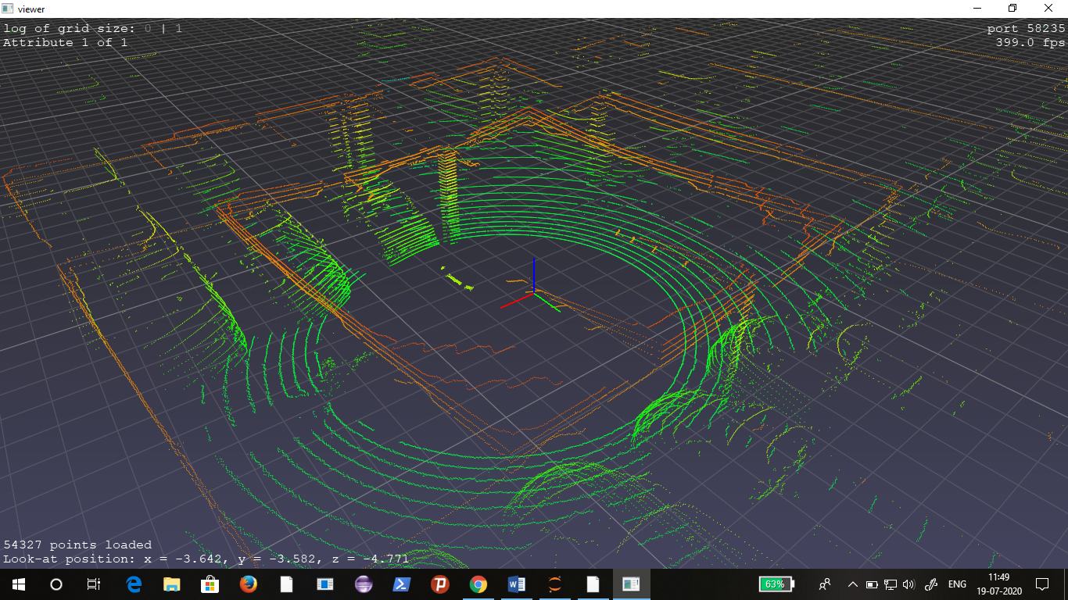
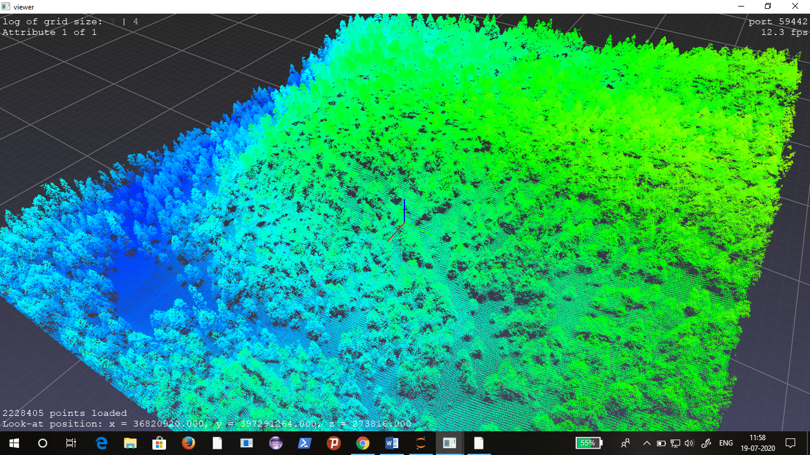
Visualization Results

Slide 12
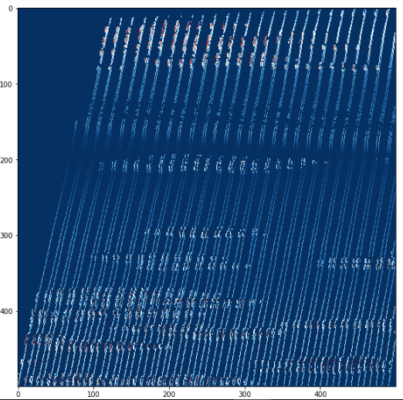
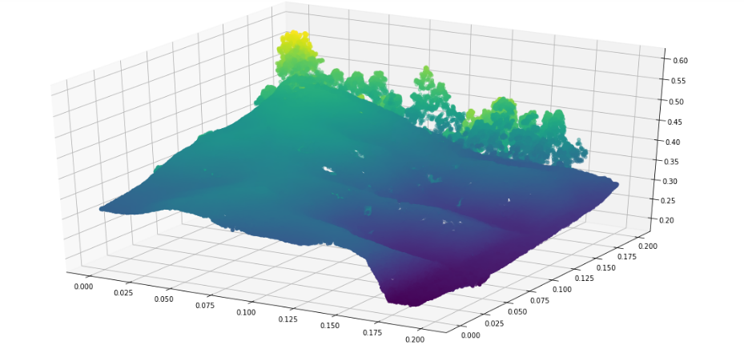
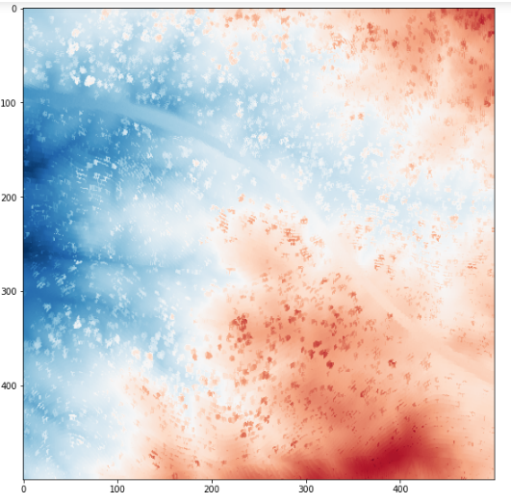
2D Image Experiments on Terrain Point Cloud

Slide 13
Conclusion
Popular point cloud formats and how to use them for visualization
Development of GUI for point cloud visualization and 3D reconstruction
Experiment on 2D image creation for 3D point cloud data

Slide 14
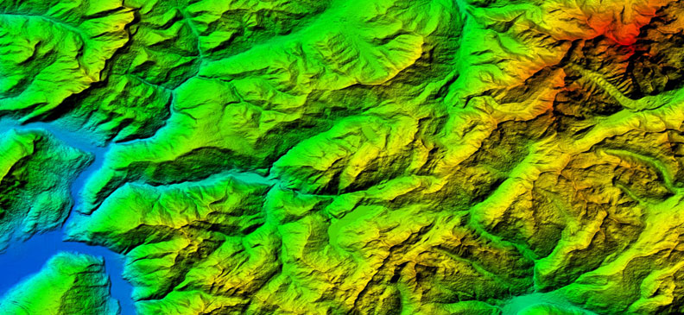

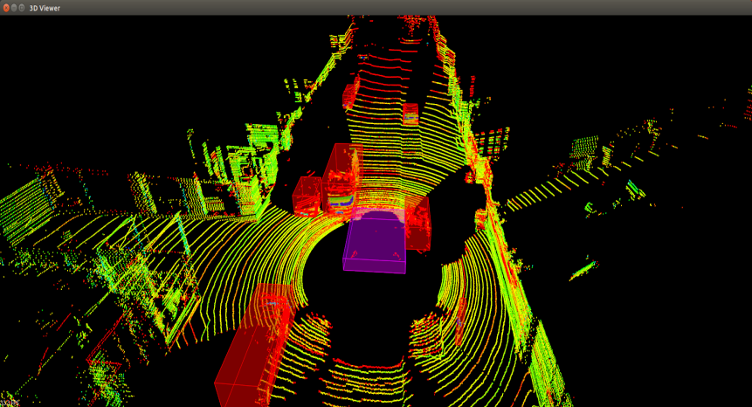
Future Work
DEM and 3D solid construction
Implementation and testing of PCL
Object Detection

Slide 15
References
[1] Yan, Z., Duckett, T. & Bellotto, N. Online learning for 3D LiDAR-based human detection: experimental analysis of point cloud clustering and classification methods. Auton Robot 44, 147–164 (2020). https://doi.org/10.1007/s10514-019-09883-y
[2] Fernandez-Diaz, Juan & Singhania, A. & Caceres, Jhon & Slatton, K & Starek, Michael & Kumar, R & Slatton, Prof. (2008). An overview of lidar point cloud processing software.
[3] http://www.semantic3d.net/view_dbase.php?chl=1
[4] http://www.acfr.usyd.edu.au/papers/SydneyUrbanObjectsDataset.shtml
[5] http://data.ign.fr/benchmarks/UrbanAnalysis/
[6] https://cs.nyu.edu/~silberman/datasets/nyu_depth_v2.html
[7] http://www.cs.cmu.edu/~vmr/datasets/oakland_3d/cvpr09/doc/
[8] https://laspy.readthedocs.io/en/latest/
[9] https://blog.pollithy.com/python/numpy/pointcloud/tutorial-pypcd
[10] https://docs.python.org/3/library/tkinter.html
[11] https://heremaps.github.io/pptk/

